Slide 1
Towards a system to aid communication with Deaf Submitted by Ah.Zia Yosufi & Mehreen Najm Under the Suprevision of Assist.Prof Rafiullah Momand Information systems Department Computer Science Faculty Kabul University

Slide 2
Outline
Introduction
Problem definition
Literature Review
Research Goals
Dataset gathering
Implementation
Train/Test system
Conclusion

Slide 3
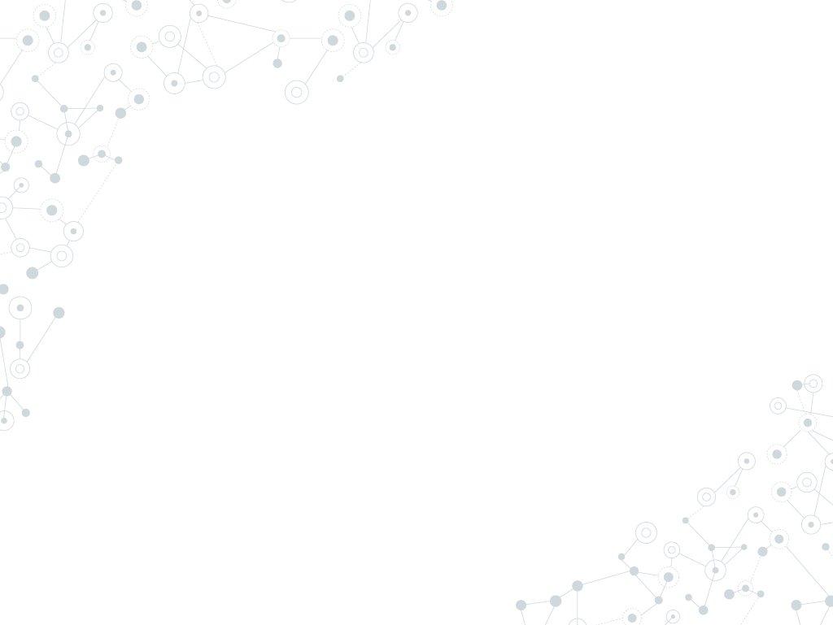

Introduction
Deaf are people who can’t talk and hear, hearing people are unfamiliar with Deaf because they don’t know their language. [1]
Sign language for deaf people has special features that are quite different from those of spoken language. Sign language is an iconic language compared to spoken language, which is more of an arbitrary one. Another crucial difference between the two languages is that sign language does not have its own writing system. Therefore, in order to write descriptions of signs, line drawings, photographs and illustrations have commonly been used, but these represent only a very small moment in the process of actual signing. [2]

Slide 4
1.
Problem Statement
In our modern information and communication society, daily life would be unimaginable without technology. Information and Communications Technology (ICT) is also very useful for people with special needs.
People think that if you cannot hear, you can easily access any necessary information by simply reading it in written form, and if you really need to communicate, you can always write your message down. [1]
But this system is not an efficient way to communicate, Deaf have their own language of communication (sign language), they can only understand this language and also they write and read Faster on sign writing.
According to survey in 2015, there are 121 “Deaf sign languages” in the world, but there is not such an efficient mechanism where Deaf can easily understand people thoughts. [3]

Slide 5
Litrature Review

Slide 6
Area 1: TESSA
TESSA is an experimental system that aims to aid transactions between a deaf person and a clerk in a Post Office. [4]

Slide 7
Area 2: HandTalk
Founded in 2012, Hand Talk performs digital and automatic translation into the Brazilian Sign Language.[5]

Slide 8
Goals
This in turn requires the solution of the following problems:
Automatic speech to text conversion (speech Recognition).
Automatic translation of English text into a suitable representation of sign language using Machine Translation.
Display of this representation as a sequence of Signs using computer graphics techniques.
We will suggest an efficient mechanism/system that Deaf can easily communicate with ordinary people to understand their thoughts.
We are using International Sign language that later any sign language can be embedded with it.
We are using SignWritingOneD.

Slide 9
Dataset Gathering
The dataset used is a sample of common words and sentences that deaf are using daily.
We have searched many sources for gathering dataset such as Wikipedia pages, some books like (Goldilocks & the Three Bears in American Sign Language, The Book of Jonah) , Signbank and other sources
the dataset that was used for this project is a subset of a much larger dataset, as described in http://www.signbank.org/signbank.html
This source includes around 10000 words and sentences.

Slide 10
Dataset Representation Vectors
𝠀񀀁񀀉񈗥񈗵񋸦𝠃𝤝𝤨񀀁𝤎𝣤񀀉𝣰𝣮񈗥𝤏𝤇񈗵𝣱𝤑񋸦𝤆𝤜 Come
𝠀񀀁񆨡񋲡񍦁𝠃𝤟𝤬񍦁𝣴𝣵񀀁𝣾𝤎񆨡𝤓𝤚񋲡𝤓𝤤 Throw in mouth
𝠀񀀡񂤁񃋁񀭡𝠃𝤰𝤖񀀡𝣜𝣷񂤁𝣰𝤁񃋁𝤅𝣹񀭡𝤙𝣷 163
𝠀񀀁񌟡񍪡𝠃𝤘𝤫񌟡𝣴𝣵񍪡𝣴𝣵񀀁𝣸𝤍 shhh!

Slide 11
Implementation

Slide 12
Train and Test System
prepare the dataset
Create a tf.data dataset
Write the encoder and decoder model
Define the optimizer and the loss function
Checkpoints (Object-based saving)
Training
Translate
Restore the latest checkpoint and test manually

Slide 13
References
[1] Al-Fityani, Kinda, and Carol Padden. "Sign language geography in the Arab world." Sign languages: A Cambridge survey (2010): 433-450.
[2] Kato, Mihoko. "A study of notation and sign writing systems for the deaf." Intercultural Communication Studies 17, no. 4 (2008): 97-114.
[3] Al-Fityani, Kinda, and Carol Padden. "Sign language geography in the Arab world." Sign languages: A Cambridge survey (2010): 433-450.
[4] Cox, S., Lincoln, M., Tryggvason, J., Nakisa, M., Wells, M., Tutt, M. and Abbott, S., 2002, July. Tessa, a system to aid communication with deaf people. In Proceedings of the fifth international ACM conference on Assistive technologies (pp. 205-212). ACM.
[5] https://www.handtalk.me/sobre

Slide 14
Thanks!

